Slide 1
Online Testing System Assessment Viewing Application (AVA)
Training Module
2023–2024
Copyright © Cambium Assessment, Inc. All rights reserved.
Notes:
Welcome to the Assessment Viewing Application (AVA) training module. AVA is a component of the online testing system that allows authorized users to view interim assessments for administrative or instructional purposes. This training module is designed to help you navigate AVA; however, you should consult the Assessment Viewing Application User Guide located on OSAS Portal (https://osasportal.org/) for features implemented by your state.

Slide 2
Objectives
After viewing this presentation, you should understand how to
Log in to AVA;
Access the assessments; and
Navigate through the test.
Notes:
After viewing this presentation, you should understand how to
Log in to AVA;
Access the assessments; and
Navigate through the test.

Slide 3
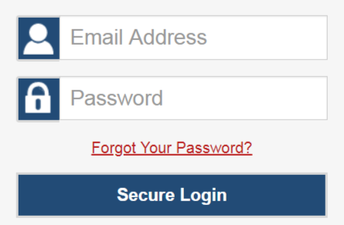
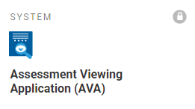
Logging in to AVA
Notes:
To access AVA, you must have an authorized email address and password, which are the same as the ones you use for the Test Information Distribution Engine (TIDE) and the Test Administrator (TA) Interface. Contact your District Test Coordinator if you do not have a TIDE account.
To log in to AVA, go to the OSAS Portal and click the Interim Assessments tab. On the next page, select the AVA System card. Enter your email address and password, and then select Secure Login.

Slide 4
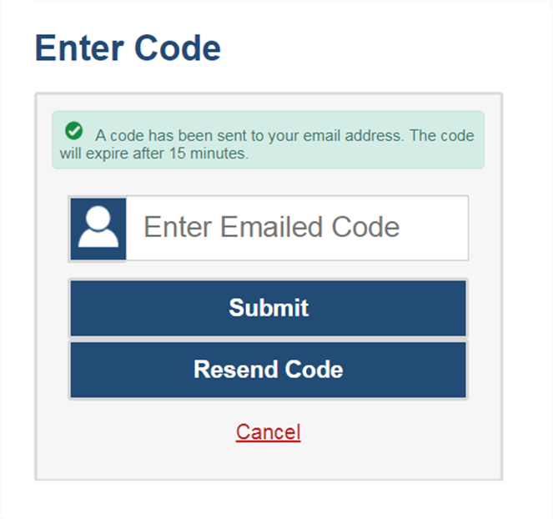
Logging in to AVA (continued)
The system has an authentication process that will be triggered when you log in from a different device or browser, or after clearing your browser’s cache.
If you see this screen, an email containing the code will have been sent automatically to your email address.
Enter the code and select Submit.
If you need the code resent, select Resend Code.
Notes:
When logging in to the system using a new device or browser, or after clearing the cache on a previously-used browser, you will see an Enter Code page.
If you see this screen, you will need to enter the code on this page within fifteen minutes of receiving the email. If you do not receive a code or do not enter the code within the fifteen-minute time limit, select Resend Code. Select Submit after entering the authentication code to access the system.

Slide 5
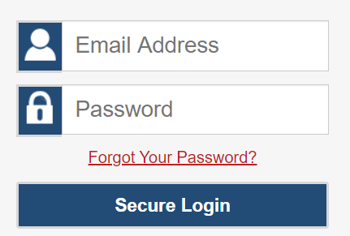
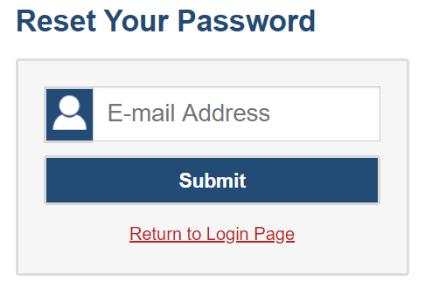
Resetting Your Password
Notes:
If you forget your password, you will need to reset it in order to access AVA.
You may need to reset your password in the following situations:
You forgot your password.
Your activation link expired.
Your account is locked because you exceeded the account login attempt limit.
It is a new school year.
To reset your password, select the Forgot Your Password? link. You will be taken to the Reset Your Password page. Enter your email address and select Submit.

Slide 6
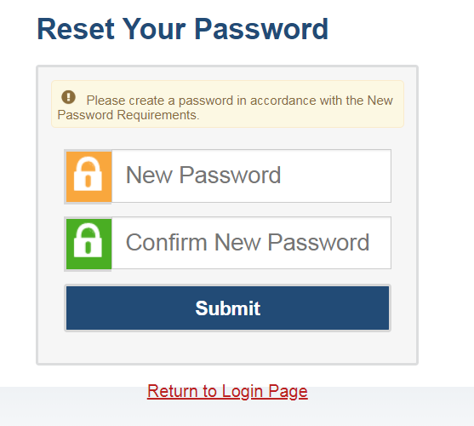
Resetting Your Password (continued)
Passwords must meet the following conditions:
Be at least eight characters long
Contain at least one lowercase alphabetic character
Contain at least one uppercase alphabetic character
Contain at least one number
Contain at least one special character
Notes:
Next, you will receive an email with an activation link. After you select the activation link, you will be taken to the Reset Your Password page.
In the New Password and Confirm New Password fields, enter a new password. The password must be at least eight characters long and must include at least one lowercase alphabetic character, one uppercase alphabetic character, one number, and one special character.

Slide 7
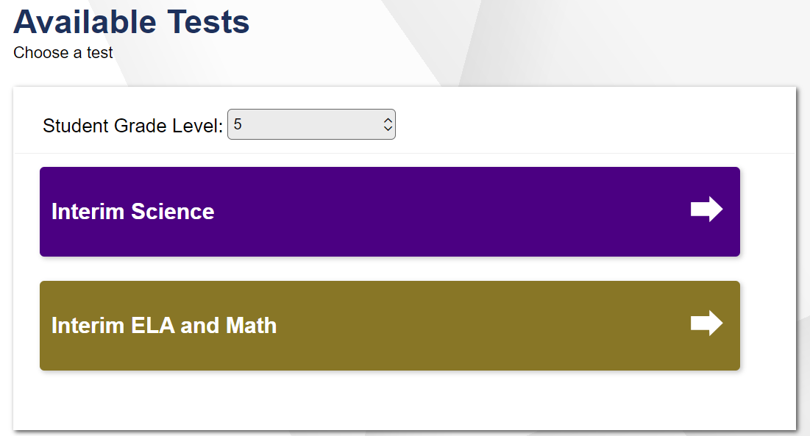
Choosing a Test to Review
Notes:
After logging in, the Available Tests page will appear.
From the Student Grade Level drop-down list, select a grade level to view the available tests for that grade.
Next, select the name of the test you wish to review. The Audio/Video checks page will appear.

Slide 8
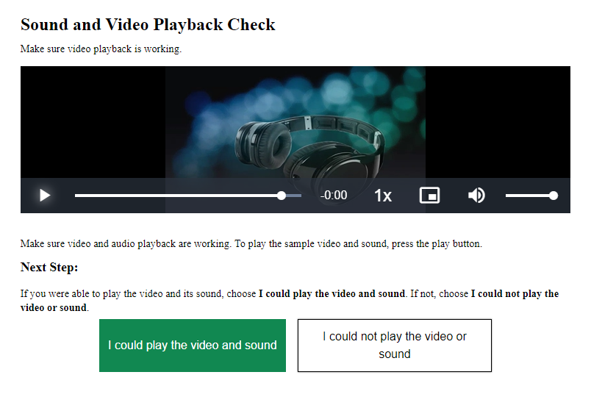
Sound and Video Playback Check
Notes:
The Audio/Video Checks page allows you to verify the functionality of any audio and video features the test may include. Each functionality check will appear in a separate panel on the Audio/Video Checks page. Additional functionality check panels appear in the live testing environment that are not reproduced in AVA.
To perform the Sound and Video Playback Check:
Select the play button to play the video and audio.
If you can see the video and hear the audio, select the I could play the video and sound button to proceed.
If you cannot see the video and/or hear the audio, select the I could not play the video or sound button and consult your technology coordinator for assistance.

Slide 9
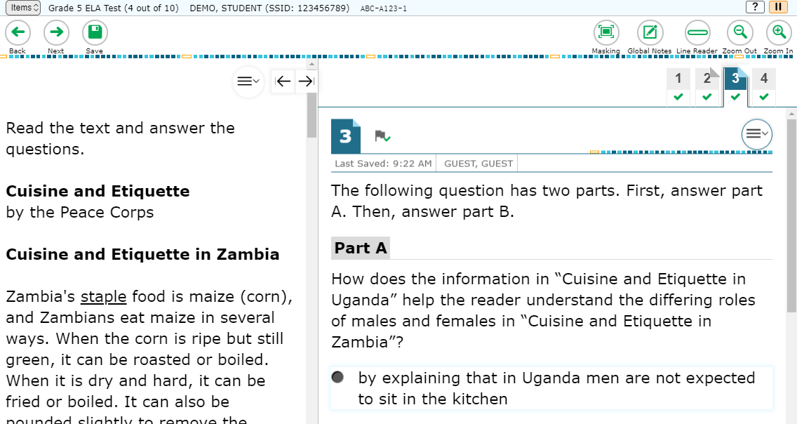
Understanding the Test Page
Global Menu
Context Menu
Notes:
This slide displays a sample test page. AVA includes several on-screen tools, including global tools and context menu tools. Global tools are available on every page in the banner. These include the Back, Next, Save, and Zoom buttons. The context menu displays the tools available for that test item. For a detailed list of tools, consult your Assessment Viewing Application User Guide.

Slide 10
Responding to Items
Notes:
Next, we will discuss how to navigate a test, pause a test, and complete a test review.
When viewing a test, you can practice responding to each test item. You can also select Next to move through the assessment without responding to an item. Pages may have only a single item, or they may contain multiple items. Responses you enter will not be scored when you complete the test review.

Slide 11
Navigating to Items
Notes:
You can navigate to items page-by-page or jump directly to an item’s page.
To navigate page-by-page, select the Back or Next buttons at the top of the screen.
To jump directly to an item page, select the appropriate item from the Items drop-down list. The Items drop-down list contains all items completed thus far and displays a blue flag for items that have been marked for review.
When multiple items are grouped with a stimulus, the items are tabbed for individual viewing. The paginated tabs are located in the upper-right corner of the test interface.

Slide 12
Pausing Tests
Notes:
You may pause the test at any time. Pausing the test automatically logs you out of AVA. You are unable to resume tests in AVA. To restart the test, you must log back in and select the appropriate test again.
To pause the test, select Pause in the banner. A “Warning” message will appear. Select Yes to confirm that you want to pause the test.
As a security measure, you are automatically logged out and your test is paused after 20 minutes of inactivity.

Slide 13
Reviewing Marked Items
Notes:
To finish reviewing the test, click Next on the last page. A review page will appear. Select an item number to return to and review that item. You can navigate through the test as before. You can return to the review page by selecting Review from the Items drop-down in the top-left corner.
When you are finished reviewing, select Submit Test.

Slide 14
Completing the Review
Notes:
You will be asked one more time to confirm that you are done viewing the test. Select No to return to the review page, or select Yes to complete the test.

Slide 15
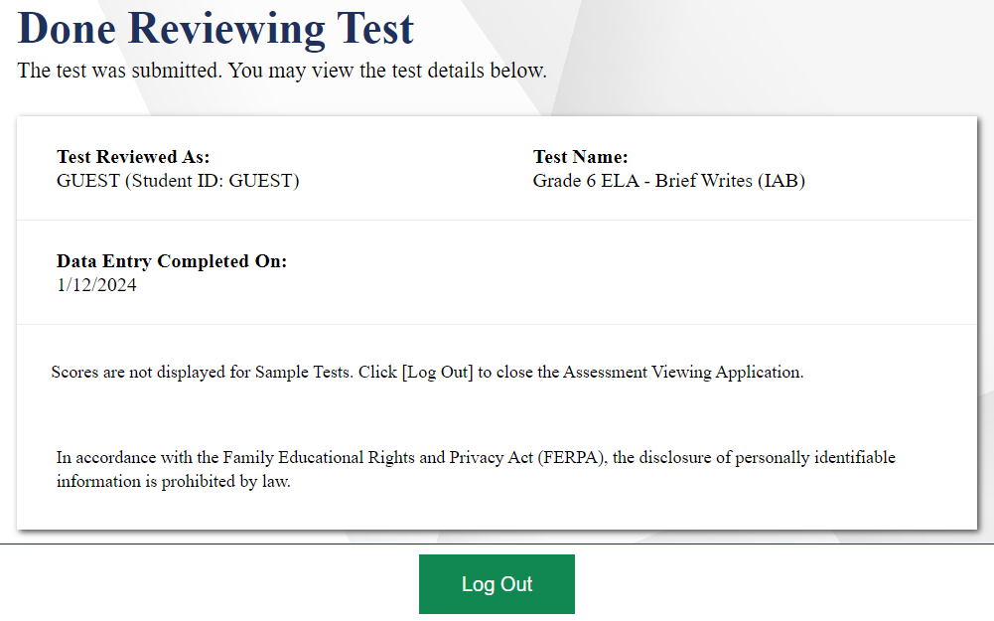
Logging Out
Notes:
The Done Reviewing Test page displays a confirmation that the test review is over. Select Log Out to return to the AVA Login page.

Slide 16
Thank You!
Further Information
OSAS Portal: https://osasportal.org
OSAS Helpdesk Phone: 1-866-509-6257
OSAS Helpdesk Email: osashelpdesk@cambiumassessment.com
OSAS Helpdesk Chat Support: https://osasportal.org/contact.html
Notes:
Thank you for taking the time to view this training module. For additional information, refer to your Assessment Viewing Application User Guide located on the OSAS portal or contact the OSAS Help Desk.

